Slide 1
Preliminary Insights
January 2022

Slide 2

Scope

Slide 3




Scope
1st Sep 2020 – 21st Oct 2021
(Daily) – 416 Days
Number of orders
(RTE + FF + Grocery)
Assessment Period
Delivery Club
-2%
Brand
18%
KPI
7%
Reporting Level
Reporting Level
Total Russia

Slide 4
Model Fit

Slide 5
Model Fit
There is a strong fit with R-Square of 81.6 % and MAPE 6.6 % both within the acceptable range
Actual vs Predicted
 | Value | Acceptable Range
R Square | 81.6% | >80%
MAPE | 6.6% | <10%

Slide 6
Contribution and Effectiveness

Slide 7
Contribution – Incremental vs Base (1/2)
27% of the orders are from Media (Online + Offline) and BTL promotions ; 73 % of the contribution is from base drivers
Within Incremental, 16% is from Online media; TV contributes 6.5% of the total orders ; OOH is 0.6% and radio 0.1%
BTL contributes 3.3% of the total orders
Contribution when on air
OOH : 0.8%
Radio : 0.7%

Slide 8
Contribution – Incremental vs Base (2/2)
Within base, Total category daily active user is the biggest contributor with 55% share ;
COVID restriction has contributed 0.7% : 12-06-21 – 21-06-21*(0.1%) and 28-06-21 – 19-07-21* (0.6%)
Holidays have given a net incremental of 0.1% : New year (-0.1%) , 14 Feb (0.1%) , 23 Feb (0.1%)
YandexEda TV has low negative impact on Delivery club orders (-0.4%)
12-06-21 – 21-06-21 : All cafes, restaurants, bars and clubs are closed from 23:00 till 6:00. Food courts were closed.
28-06-20 – 19-07-21 :Only vaccinated or persons who recovered from covid are allowed to visit cafes, restaurants, museums etc.

Slide 9
Relatively low ROI for performance
Comparing the share of budget to the number of orders contribution , ROI of performance is relatively low and can be investigated further
Spend Share
Order Share
 | Contribution vs Spend share
OOH | 1.23
TV | 1.21
OLV | 1.45
Performance | 0.89
Performance contribution is less than spend Share

Slide 10
Online Media
DoubleClick showed the highest contribution, followed by Facebook ; YouTube is the most effective media followed by Facebook
Contribution
Effectiveness (per ‘000 Imp)
 | DoubleClick | Target | Google | Facebook | Appnext | Bytedance | YouTube | Target OLV | Twitter | Yandex
Impression (Mn) | 6,203 | 4,116 | 3,392 | 895 | 894 | 803 | 426 | 114 | 163 | 74
Impression Share (%) | 36.3% | 24.1% | 19.9% | 5.2% | 5.2% | 4.7% | 2.5% | 0.7% | 1.0% | 0.4%
*Effectiveness is number of orders per ‘000 impressions
Spends not available to calculate the ROI

Slide 11
Online Media – DoubleClick , Target and Google Detailed
Within tactics deployed for grocery , DoubleClick shows high effectiveness for grocery
DoubleClick Total : 5.2%
Target Total :2.1%
Google Total : 1.2%
Contribution
Effectiveness (per ‘000 Imp)
 | DoubleClick RTE+FF | DoubleClick Grocery | Remarketing DoubleClick RTE_FF | Target RTE+FF | Target Grocery | Remarketing Target RTE + FF | Remarketing Target Grocery | Google RTE + FF | Google Grocery | Remarketing Google RTE+FF | Remarketing Google Grocery
Impression (Mn) | 5,736 | 352 | 115 | 3,589 | 322 | 205 | 0.2 | 3,191 | 141 | 57 | 3
Impression Share * (%) | 33.6% | 2.1% | 0.7% | 21.0% | 1.9% | 1.2% | 0.0% | 18.7% | 0.8% | 0.3% | 0.0%
Spends not available to calculate the ROI
*Impression share is within total online media
**Effectiveness is number of orders per ‘000 impressions

Slide 12
TV Campaigns
Partnership campaigns contribute 28% of the total TV contribution whereas 72% comes from in-house campaigns. Among in-house campaigns Campaign 2 (Sep-Nov’20) is most effective followed by Campaign 6 (Apr-May’21)
Contribution
TV : 6.5%
Effectiveness (per TRP)
 | Campaign 1 | Campaign 2 | Campaign 3 | Campaign 4 | Campaign 5 | Campaign 6 | Campaign 7 | Campaign 8-10 (Partnership)
TRP | 3,030 | 2,096 | 2,850 | 2,612 | 2,443 | 2,359 | 889 | 11,387
TRP Share (%) | 11.0% | 7.6% | 10.3% | 9.4% | 8.8% | 8.5% | 3.2% | 41.2%
Spends not available to calculate the ROI
*Campaigns 1 to 7 are in-house campaigns
**Effectiveness is number of orders per TRP

Slide 13
Model Decomposition – Media and BTL (Incremental)

Slide 14
Variable used – Contribution and Coefficient (1/3)
 | Variable | Absolute Contribution | Percentage Contribution | Coefficient
 | Intercept |  |  | 16,011.6
Incremental | DoubleClick RTE + FF | 32,61,742 | 3.7% | 0.6
 | DoubleClick Grocery | 13,63,404 | 1.5% | 3.9
 | Target RTE + FF | 18,21,681 | 2.1% | 0.5
 | Google RTE+FF | 10,93,255 | 1.2% | 0.3
 | Facebook | 18,95,369 | 2.1% | 2.1
 | Appnext RTE+FF | 18,66,798 | 2.1% | 2.1
 | Byte dance RTE + FF | 16,78,788 | 1.9% | 2.1
 | YouTube | 14,37,053 | 1.6% | 3.4
 | Target OLV | 74,607 | 0.1% | 0.7

Slide 15
Variable used – Contribution and Coefficient (2/3)
 | Variable | Absolute Contribution | Percentage Contribution | Coefficient
Incremental | TV Campaign 1 | 6,60,168 | 0.7% | 217.8
 | TV Campaign 2 | 7,38,399 | 0.8% | 352.4
 | TV Campaign 3 | 6,20,967 | 0.7% | 217.8
 | TV Campaign 4 | 5,68,968 | 0.6% | 217.8
 | TV Campaign 5 | 5,32,278 | 0.6% | 217.8
 | TV Campaign 6 | 7,52,682 | 0.8% | 319.0
 | TV Campaign 7 | 2,72,504 | 0.3% | 306.6
 | TV Partnership Campaigns | 16,34,056 | 1.8% | 145.2
 | OOH | 5,09,424 | 0.6% | 0.3
 | Radio | 49,373 | 0.1% | 3.0
 | BTL | 29,52,833 | 3.3% | 28,744.8

Slide 16
Variable used – Contribution and Coefficient (3/3)
 | Variable | Absolute Contribution | Percentage Contribution | Coefficient | P - Value
Base | Friday (Effect) | 21,37,696 | 2.4% | 36,232.1 | 0.00
 | Sat (Effect) | 28,34,983 | 3.2% | 48,050.6 | 0.00
 | Sun (Effect) | 24,73,525 | 2.8% | 41,924.2 | 0.00
 | March (Seasonality) | -5,77,804 | -0.7% | -18,638.8 | 0.00
 | June (Seasonality) | 11,42,323 | 1.3% | 38,077.4 | 0.00
 | Oct (Seasonality) | 10,73,961 | 1.2% | 20,653.1 | 0.00
 | Jan (Seasonality) | -4,78,227 | -0.5% | -15,426.7 | 0.01
 | July (Seasonality) | 3,06,738 | 0.3% | 9,894.8 | 0.31
 | 14-Feb | 64,772 | 0.1% | 64,772.3 | 0.00
 | 23-Feb | 82,274 | 0.1% | 82,273.5 | 0.00
 | New Year | -99,779 | -0.1% | -99,779.4 | 0.00
 | YandexEda TV | -3,40,190 | -0.4% | -103.7 | 0.31
 | Covid Restrictions (12-06-21 – 21-06-21) | 55,152 | 0.1% | 5,515.2 | 0.49
 | Covid Restrictions(28-06-21 – 19-07-21) | 5,27,039 | 0.6% | 23,956.3 | 0.00
 | Total_Catg_DAU | 4,91,78,950 | 55.4% | 0.1 | 0.00

Slide 17
Demand Drivers

Slide 18
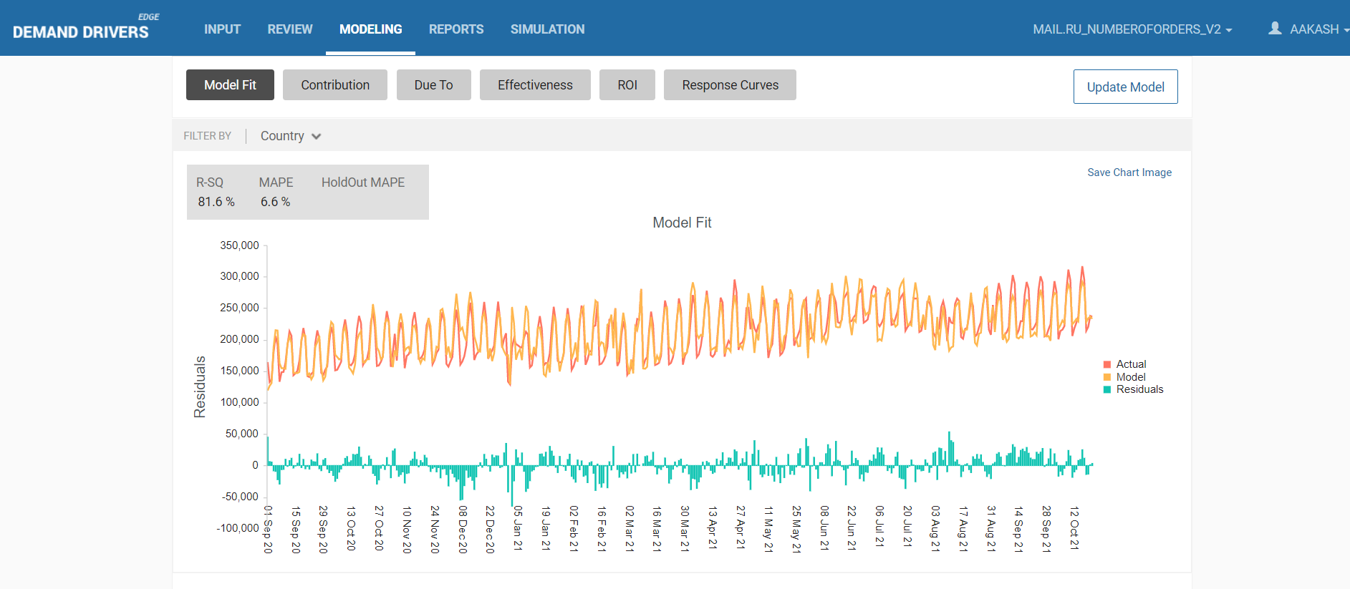
Model Fit

Slide 19
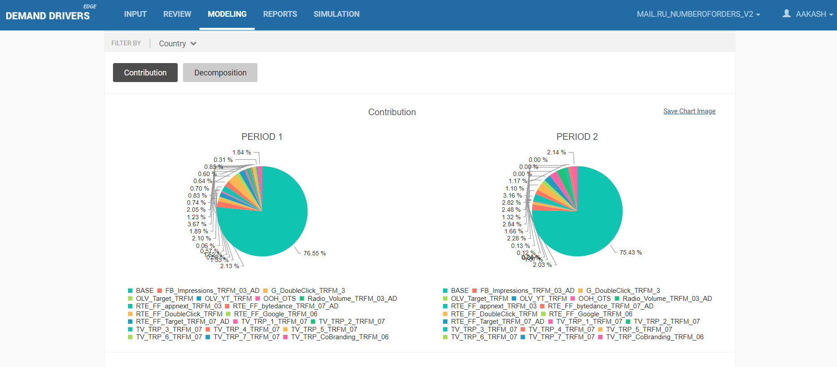
Contribution : Scope to compare different time periods as well in tool

Slide 20
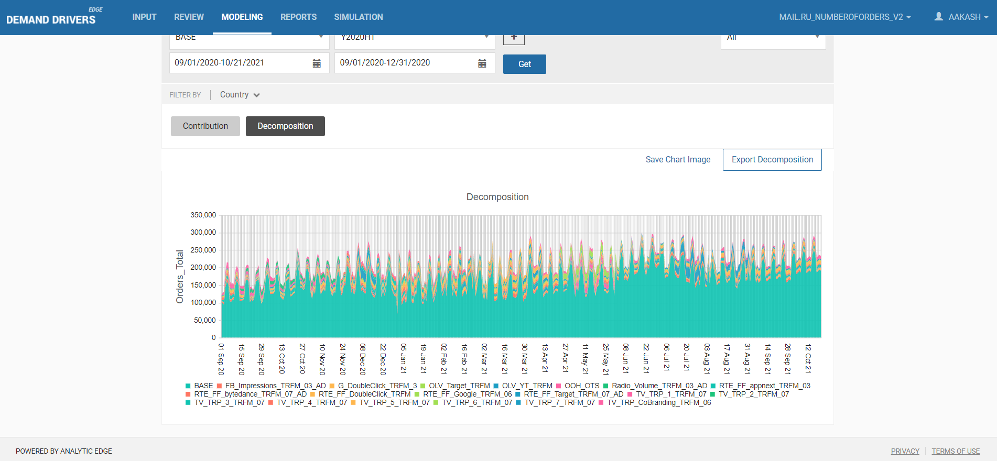
Decomposition

Slide 21
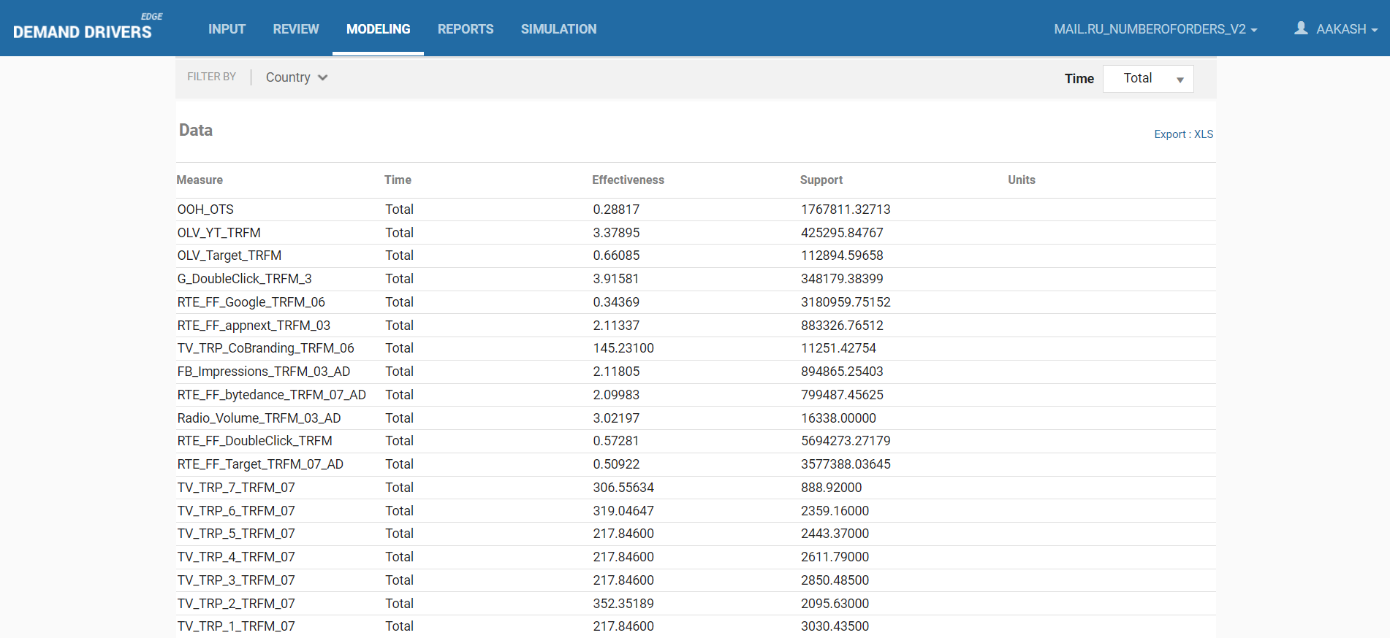
Effectiveness

Slide 22
Thank You

Slide 23
Appendix

Slide 24
Google Impressions
Google impressions on RTE+FF increased over time and then declined from Apr ‘21. Impressions on Grocery and remarketing are comparatively small
Google Impressions
Impressions (‘000) | Q4’ 2020 | Q1’ 2021 | Q2’ 2021 | Q3’2021 | Total
RTE + FF | 754,657 | 1082,550 | 606,965 | 474,022 | 3,191,310
Grocery | 32,321 | 23,816 | 25,983 | 42,523 | 140,950
Remarketing RTE&FF | 1,963 | 21,355 | 9,306 | 24,170 | 56,808
Remarketing Grocery | - | - | - | - | 3,003 *
43%
-44%
-22%
-26%
9%
64%
988%
-56%
160%
*Impressions from Oct’21 (Q4’21)

Slide 25
DoubleClick Bid Manager Impressions
DoubleClick Bid Manager impressions on RTE+FF increased till Jan’21 and then declined over time; Grocery and remarketing impressions are relatively small
DoubleClick Bid Manager Impressions
Impressions (‘000) | Q4’ 2020 | Q1’ 2021 | Q2’ 2021 | Q3’2021 | Total
RTE + FF | 963,822 | 1,672,196 | 1,057,735 | 1,453,901 | 5,736,258
Grocery | 51,137 | 103,064 | 77,666 | 84,051 | 351,954
Remarketing RTE&FF | 26,295 | 26,202 | 24,607 | 17,336 | 115,092
73%
-37%
37%
102%
-25%
8%
-
-6%
-30%

Slide 26
OLV Impressions – YouTube and target.mail.ru
OLV YouTube impressions are increasing over time , Facebook OLV impressions increased from Q1’21 .Target.ru has a huge spike in Feb’21
OLV Impressions
OLV Impressions (‘000) | Q4 2020 | Q1 2021 | Q2 2021 | Q3 2021 | Total
YouTube | 17,811 | 49,409 | 138,264 | 213,114 | 426,307
Target.mail.ru | - | 35,616 | 53,412 | 18,075 | 114,080
177%
180%
54%
50%
-66%

Slide 27
TV Campaign Details
TV TRP
Campaign 2
Campaign 4
Campaign 5
Campaign 6
Campaign 7
Campaign 1
Campaign 3
 | Campaign 1 | Campaign 2 | Campaign 3 | Campaign 4 | Campaign 5 | Campaign 6 | Campaign 7 | Partnership
TRP | 3,030 | 2,096 | 2,850 | 2,612 | 2,443 | 2,359 | 889 | 11,387
Share (%) | 11.0% | 7.6% | 10.3% | 9.4% | 8.8% | 8.5% | 3.2% | 41.2%

